Slide 1
Discussion Module:
Learn to deliver DSE Geospatial queries. E.g., Where’s the nearest Starbucks-
Prerequisites to this Discussion Module:
That you are comfortable with making and using DSE Search chained analyzers.
That you are comfortable with DSE Search filter queries, facets, and the extended parser syntax of dismax, or edismax.
Why (above) ? Not because we use these objects per se. Comfort with these topics means DSE Search geospatial objects and query syntax will be familiar.
Discussion Module:
DSE Search, Geospatial
Notes:
The goal of this Discussion Module is to learn to deliver DSE Search geospatial queries; Where’s the nearest Starbuck’s, and related.
This module has as its prerequisites:
That you are comfortable with making DSE Search chained analyzers.
That you are comfortable with DSE Search filter queries, facets, and the extended parser syntax of dismax, or edismax. Why ? Not because we use these objects per se. Comfort with these topics means DSE Search geospatial objects and query syntax will be familiar.

Slide 2
Discussion Lab:
Next page: Why are there points returned from a DSE Search geospatial query that display outside of the search area ?
Open Probe
Notes:
On the next page we enter a Discussion Lab.

Slide 3


Geospatial versus Spatial
Geospatial; spherical mathematical model, (the Earth is nearly a sphere). Distance calculated relative to curved surface.
Spatial; Cartesian, two dimensional mathematical model
Notes:
The image above is a screen shot from the sample (end user testing) Web program we reference in this document.
In this image, we ran a geo-spatial query against a set of 330,000 geo-points bounded by a polygon. The (polygon) is displayed in red, and the returned points in blue. (The corners of the polygon are in orange.)
If you look closely, a small number of the returned points fall outside the polygon. Why ?

Slide 4
End of Discussion Lab:
Notes:
End of Discussion Lab-

Slide 5
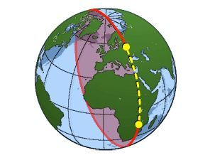
What Makes a Query Geospatial, Spatial, (other) ?
Field types
No analyzer needed (no text to parse).
Common/past use of dynamicField. E.g., Take a Lat/Lon pair, and index each decimal value.
Basically, extended common numeric types.
To query: New predicate expressions
But the answer is: Field Types
Source: https://spherelandma508.wordpress.com/about/
Notes:
Minus new field types, and a number of new query predicates, you already know the syntax and use of geospatial queries. At this moment, you should already know how to read a geospatial query and have it make sense.

Slide 6
Geospatial versus Spatial
Geospatial- The Earth is not perfectly round (huge mountains, deep valleys); don’t care, but still better than imagining the world is flat. Account for international date line.
Spatial; points sit atop a flat plane, x/y coordinate pair
- How far are products on either side of a warehouse
- Also, time series; start and end dates/time
Notes:
Syntactically, the difference between geospatial and spatial queries is small. The use cases differ, however.

Slide 7
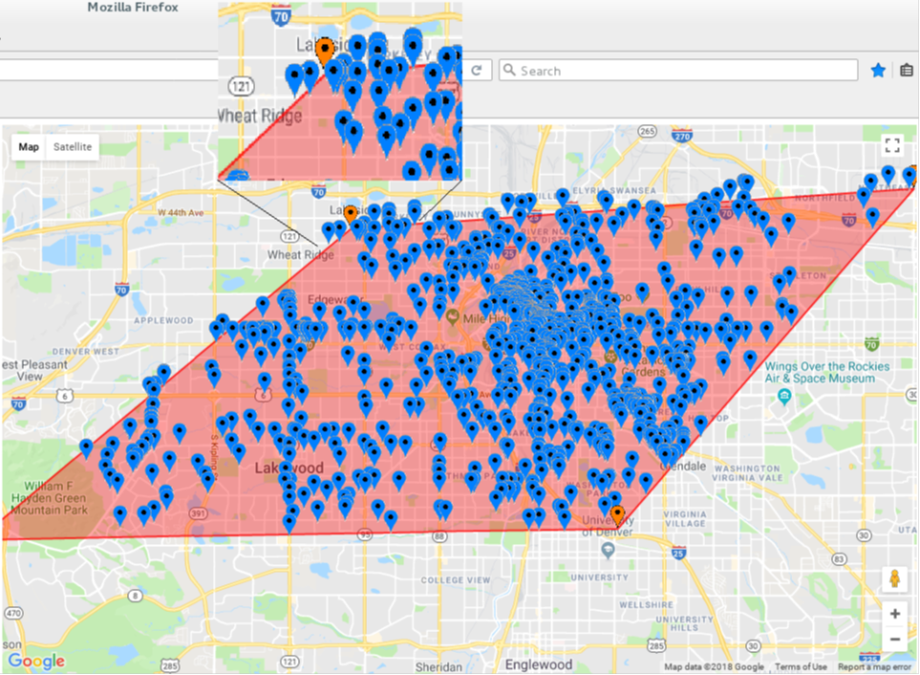
Choices: (Spatial Strategy)
RDBMS: volatile data, B-Tree+
DSE: Web scale data sizes, hash (and)
Geospatial
Distance from point ?
Intersection of boundaries of geometric shapes ?
Other
distErrPact, distErr ? (configurable, tunables)
2D polygon on 3D world ?, 3D polygon on 3D world ?
Notes:
Just as normal data access patterns determine a more optimal storage and retrieval method for (standard databases), the same is true for databases serving geospatial/spatial data and queries. If you give greater focus to distance from a point, versus points contained within a geometric shape and intersection therein, there are design optimizations you may choose.

Slide 8
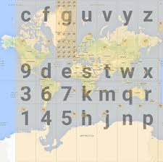
Coarse Description of Geohash-
Take the Earth, and divide it into 32 equal sized rectangles.
Take each of the rectangles above, and divide those into 32 (further, sub) rectangles.
After you iterate the above cycle 4 times, you have divided the Earth into distinct regions as accurate as 12 meters.
By storing a unique string only 5 characters long, and an array of whatever items are located in this distinct (144 meter square region of the Earth), you can serve a lot of geo-spatial queries quickly and easily.
Further, if you also index not only the 5 character string, but all substrings of the 5 character string, you have many highly performant choices.
Notes:
Geohash is one means to index geospatial data. On some level, a geohash has many similarities to precisionIncrementGap related to scalar indexes.
References Urls:
https://en.wikipedia.org/wiki/Geohash
https://en.wikipedia.org/wiki/Quadtree

Slide 9
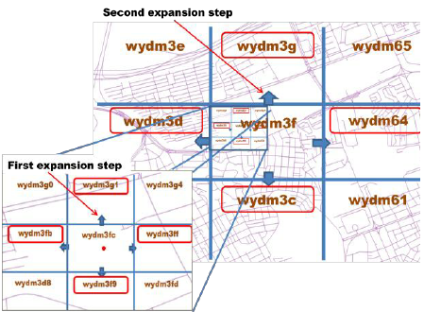
Coarse Description of Geohash, Example-
If a 5 character string that tells us that Boston/MA/USA equates to the string constant, DRY2Y, we should also index the sub-strings of DRY2Y, those being; D, DR, DRY, DRY2 (DRY2Y already being indexed).
When we need to find all points within 100 miles/km of the point, DRY2Y, we need only look for the equality, DRY (or whatever the actual accuracy is).
Notes:
The product of a geohash is a key is some length. The leading substrings of the geohash key hold value; they define the hierarchically larger areas (of the complete key). Thus, these substrings serve range queries, basically, via an equality. And, from the discussion of DSE Core, you know why preference is given to equalities versus ranges.
References Urls:
https://en.wikipedia.org/wiki/Geohash
https://en.wikipedia.org/wiki/Quadtree

Slide 10
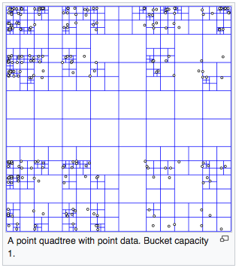
Geohash and/or Quadtree
DSE Search geospatial/spatial uses geohash, or also quadtree.
For now we state,
DSE Search uses geohash for geodetic data only (geo-spatial only).
DSE Search uses quadtree for either geo-spatial or spatial data, including temporal data (time series data).
Implemented as TermsEnum; highly performant, allows set operands (unions, intersections, other)
Notes:
While similar, there is slight optimization to each; geohash, and quadtree. By the field types and associated attributes you choose, you directly/indirectly implement a geohash or quadtree in the DSE Search runtime..
References Urls:
https://en.wikipedia.org/wiki/Geohash
https://en.wikipedia.org/wiki/Quadtree

Slide 11
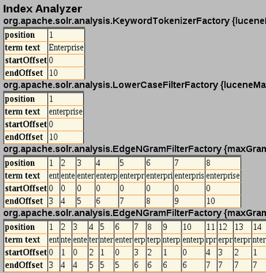
Solr Filter (Left Edge) N-gram filter ?
Now you know a use case for left edge N-Gram; break a token like DRY2Y into further tokens, D, DR, DRY, ..
By preindexing (indexing) each of the sub-elements of the token (DRY2Y), you allow for fast filtering of ranges.
Notes:
Geohash and quadtree, and an earlier reference to precisionIncrementGap, now you have a use case for the (left edge N-Gram) filter to standard DSE Search text analytics. With (left edge N-Gram), you can deliver your own geohash/quadtree.
Reference Urls:
https://lucene.apache.org/solr/guide/6_6/filter-descriptions.html

Slide 12
Must reads on Geospatial-
David Smiley at MITRE on Apache Solr spatial/geo-spatial is available at,
https://www.youtube.com/watch?v=L2cUGv0Rebs
https://www.slideshare.net/lucenerevolution/lucene-solr-4-spatial-extended-deep-dive
Notes:
If you really want to master DSE Search, geospatial, the above resources should be considered must reads.
Reference Urls:
https://www.youtube.com/watch?v=L2cUGv0Rebs
https://www.slideshare.net/lucenerevolution/lucene-solr-4-spatial-extended-deep-dive

Slide 13
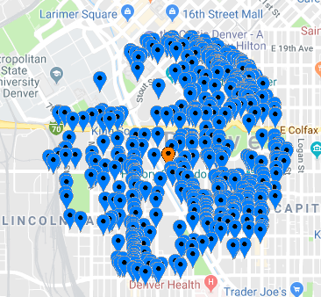
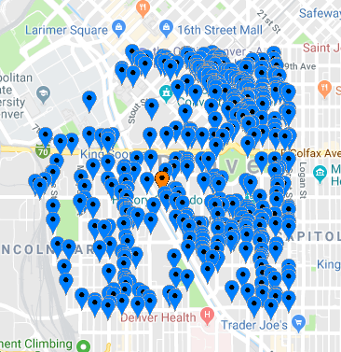
Geospatial, Seminal Use Case
numFound: 2917, maxScore: 1.0, elapsed time: 2 ms
Index a Lat/Lon pair
Search for rows within a point-radius (circle), or bounding box
It is measurably more efficient to look for a point within a box, versus a circle. (Easier math.)
Sort results by distance from said point.
numFound: 4949, maxScore: 1.0, elapsed time: 3 ms
Notes:
To state explicitly then; the first, and seminal use case for Apache Solr geospatial was distance from a point.

Slide 14

End to End Example:
DSE cluster, with Search enabled
Authority to make tables, other
CQLSH/Studio access-
Example uses field type LatLonType, which is most common
Distance from point, radius, bounding box, arbitrary rectangle.
Notes:
At this point we present an example; complete, and end to end.
The example we detail is delivering query from a point, by radius and bounding box, arbitrary rectangle.

Slide 15

Distance from Point: CREATE KEYSPACE
DROP KEYSPACE IF EXISTS ks_7453;
CREATE KEYSPACE ks_7453 WITH REPLICATION =
{'class': 'SimpleStrategy',
'replication_factor': 1};
USE ks_7453;
CREATE TABLE t1
(
col1 TEXT,
my_latlong TEXT,
PRIMARY KEY ((col1))
);
Notes:
Familiar CQL code; make a keyspace and table.
While numeric (decimal) data, latitude/longitude pairs are inserted/updated as text, with either a comma separator or whitespace separator. It is possible, based on field type, that you explicitly need a comma or whitespace separator.

Slide 16
Distance from Point: Add Data, CREATE INDEX
INSERT INTO t1 (col1, my_latlong)
VALUES ('1', '38.8623758053, 106.214532852');
VALUES ('2', '38.8618662055,
-106.212043762');
VALUES ('3', '30.8702532527,
-100.264572144');
VALUES ('4', '-30.8702532527,
-100.264572144');
CREATE SEARCH INDEX ON t1
WITH COLUMNS col1 ;
Data type ?
(Eventually; data integrity constraint ?
Notes:
Formatting of text for the Solr.LatLonType field type; comma, latitude, then longitude.
As a (lat/lon) field type, there will be no data validation as a result of the index that will be in place; latitude +/=90, Longitude +/= 180. Some libraries [ may ] correct an overage; E.g., wrap around the international date line.

Slide 17

Distance from Point: Add Field Types
ALTER SEARCH INDEX SCHEMA ON t1
ADD types.fieldType[@name='ft_latlong',
@class='solr.LatLonType',
@subFieldSuffix='_coord'];
ALTER SEARCH INDEX SCHEMA ON t1
ADD types.fieldType[@name=
'ft_double', @class='solr.TrieDoubleField'];
Notes:
Each of the statements above is required. Comments:
The first [ field type ] above is that which you will create a [ field ] for; insert into, and query upon. This field type will be the (public facing) field type, if you will. All other field types / fields will operate behind the scenes.
As a lat/lon pair, this (field) will, under the covers, be split into two decimals. The second field type will be used for that purpose.
Back to the first field; How will DSE Search know which decimal field(s) to use upon splitting the text value ? Two fields ending with the substring “_coord” , will be used for this purpose. (Next page.)
At this point, these are just ( types ). We are still assembling the complete use case.

Slide 18
Distance from Point: ADD dynamicField, field
ALTER SEARCH INDEX SCHEMA ON t1
ADD dynamicField[@name=
'*_coord', @type='ft_double',
@indexed='true', @stored='false'];
ALTER SEARCH INDEX SCHEMA ON t1
ADD fields.field[@name=
'my_latlong', @type='ft_latlong',
@indexed='true', @multiValued='false',
@stored='true'];
RELOAD SEARCH INDEX ON t1;
REBUILD SEARCH INDEX ON t1;
Using Solr Admin UI Schema Browser:
my_latlong_0_coord
my_latlong_1_coord
Notes:
Each of the statements above is required. Comments:
The dynamicField will be the destination for the two decimals coming from insert, update, other. You will never access these field directly; just like any actual key field value. You will access the standard DSE table column value, which sits in front of this index.
And the actual field add.
RELOAD, REBUILD
Reference Urls:
https://docs.datastax.com/en/dse/5.1/dse-dev/datastax_enterprise/search/usingDynamicFields.html

Slide 19
Distance from Point: Radius (from circle)
SELECT * FROM t1 WHERE solr_query =
'{ "q" : "*:*", "fq" : "{!geofilt pt=38.86,-106.21
sfield=my_latlong d=10000}" }';
col1 | my_latlong | solr_query
------+--------------------------------+------------
4 | -30.8702532527, -100.264572144 | null
3 | 30.8702532527, -100.264572144 | null
2 | 38.8618662055, -106.212043762 | null
1 | 38.8623758053, -106.214532852 | null
Or, '{ "q" : "{!geofilt pt=38.86, ..
Notes:
And then the query syntax:
We wrote this query as a “q”, then “fq” for one reason; to show you how you might combine a text analytics or scalar set of predicates with a geospatial query. This is common. I,e., “Starbucks” within 5 miles.
All of the queries that follow can be written as “q”.

Slide 20
What is geofilt ?
{ “q” : “{!edismax qf=col6}Dog ??
{ "q" : "{!geofilt pt=38.86, -106.21 sfield=my_latlong d=10000}" }‘
It’s a query parser. So, expect parameters-
https://lucene.apache.org/solr/guide/6_6/spatial-search.html
- d, the radial distance, default km, can set via distanceUnits
- pt, the center point, “x, y” for Lat/Lon or PointType, “x y” for PRT
- sfield, the indexed field name
- (others)
Other parsers; bbox, (arbitrary rectangle), more.
Notes:
Comments:
From experience, you have seen that the “{! nnn .. “ was used to introduce a query parser; example as shown with edismax.
As a query parser, you can expect geofilt will likely have parameters, in the case; d, pt, sfield, (others).
Other query parsers include bbox, (arbitrary rectangle), more.

Slide 21
Distance from Point: Radius (from circle)
SELECT * FROM t1 WHERE solr_query =
'{ "q" : "*:*", "fq" : "{!geofilt pt=38.86,
-106.21 sfield=my_latlong d=1000}" }';
'{ "q" : "*:*", "fq" : "{!geofilt pt=38.86,
-106.21 sfield=my_latlong d=1}" }';
// Same for both
col1 | my_latlong | solr_query
------+-------------------------------+------------
2 | 38.8618662055, -106.212043762 | null
1 | 38.8623758053, -106.214532852 | null
Notes:
Different distances and results using “d”. With our small sample data set, two rows were in the distance range 1000-1 kilometer.

Slide 22
Distance from Point: Bounding Box (within square)
SELECT * FROM t1 WHERE solr_query =
'{ "q" : "*:*", "fq" : "{!bbox pt=38.86,
-106.21 sfield=my_latlong d=10000}" }';
col1 | my_latlong | solr_query
------+--------------------------------+------------
4 | -30.8702532527, -100.264572144 | null
3 | 30.8702532527, -100.264572144 | null
2 | 38.8618662055, -106.212043762 | null
1 | 38.8623758053, -106.214532852 | null
Notes:
From geofilt, we know bbox is a query parser, apparently with the same parameters.

Slide 23

Distance from Point: (Arbitrary Rectangle)
SELECT * FROM t1 WHERE solr_query =
'{ "q" : "*:*", "fq" :
"my_latlong:[38,-107 TO 39,-106]" }';
col1 | my_latlong | solr_query
------+-------------------------------+------------
2 | 38.8618662055, -106.212043762 | null
1 | 38.8623758053, -106.214532852 | null
(2 rows)
Negative values are sequenced right to left (remember the date line)
Notes:
The syntax for arbitrary rectangle is a little less obvious; example as shown. The order of points is significant. Notice the “TO” predicate expression, which we have seen to indicate, range.

Slide 24

Distance from Point: Sorting
SELECT * FROM t1 WHERE solr_query =
'{"q":"*:*", "fq": "{!geofilt sfield=my_latlong
pt=38.86,-106.21 d=30}",
"sort":"geodist(my_latlong, 38.86,-106.21) asc"}';
col1 | my_latlong | solr_query
------+-------------------------------+------------
2 | 38.8618662055, -106.212043762 | null
1 | 38.8623758053, -106.214532852 | null
"sort":"sum(col3, col4) asc" }'; ??
Notes:
Each of the statements above is required. Comments:
You can call to sort results from an arbitrary point; this is more common when querying with shapes.
geodist is a “function query”.
Other (relevant) function queries include; dist(), hsin(), sqedist().
With the (sort point) being equal to our (query point), this call to sort should be redundant.
Reference Urls:
https://lucene.apache.org/solr/guide/6_6/spatial-search.html
https://www.slideshare.net/lucenerevolution/lucene-solr-4-spatial-extended-deep-dive
(Above), slide 45, “geodist() is for Solr 3 LatLonType only”. This comment was accurate, then changed by Solr 6.

Slide 25
End to End Example:
DSE cluster, with Search enabled
Authority to make tables, other
CQLSH/Studio access-
Example uses field type LatLonType, which is most common
Distance from point, radius, bounding box, arbitrary rectangle.
REVIEW
Notes:
This page marks the end of the (end to end) example; distance from point, radius, bounding box, arbitrary rectangle.

Slide 26
Previously:
Query from point (in various means)
Field types,
- LatLonType (what we used; deprecated, use RPT for new work)
- PointType, non-geo version of LatLonType (also deprecated)
- LatLonPointSpatialField (97% backwards compatible with above, but ??)
- SpatialRecursivePrefixTreeFieldType (RPT) &
RptWithGeometrySpatialField
- BBoxField
https://lucene.apache.org/solr/guide/6_6/spatial-search.html
Adds
Where have we heard this term before ?
Notes:
Comments:
While the preceding examples used LatLonType, it is deprecated and you should use LatLonPointSpatialField (LLPSF). Why didn’t we use LLPSF ? While LLPSF is supposed to be backwards compatible, (Apache Solr defects in code or documentation, other), some of our sorts failed to work with LLPSF. Stay tuned.
LLPSF supports query using radius (circle), box and rectangle. When you move into polygons and related, you must use a new field type; RPT.
RPT also requires a new library to be installed; JTS (Apache Java Topology Suite). Due to the specific open source license terms, JTS must be installed outside/after installing DSE.
BBoxField; while we did a query using the bbox query parser, there is an optimization to be made. Recall geohash/quadtree ? BBoxField indexes the (points) differently, and in a more optimal manner when querying via (boxes).
Reference Urls:
https://lucene.apache.org/solr/guide/6_6/spatial-search.html

Slide 27
Sort Changes with Field Type
The syntax to sort changes when using different field types
90+% of examples in world are LatLonType
Skip LatLonPointSpatialField ??
Move to RPT-
- Can support for polygons, but polygons not required
- No dynamic field required
- No commas to data
- Different sort syntax
Notes:
When moving past use of LatLonType, the syntax to sort results changes. Given that, and the deprecated nature of LatLonType, why did we use it in the first example ?
LatLonType is what you will see in 90+% of the examples you Google
LatLonType is more complex, depending on a dynamicField, and we wanted to document that.
RPT should be the standard moving forward. Comments:
Basically RPT can perform every function; syntax is more complex, and different than before when sorting
Data is entered without commas
No dynamicField is required
While polygons are supported, they are not required. Using polygons adds another rumtine dependency.

Slide 28
LatLonPointSpatialField, other .. sort will change
ALTER SEARCH INDEX SCHEMA
ON t2 ADD types.fieldType[
@name='ft_latlong',
@class='solr.SpatialRecursivePrefixTreeFieldType',
@distErrPct='0.025', @maxDistErr='0.000009',
@units='degrees'];
...
SELECT * FROM t2 WHERE solr_query =
'{"q":"*:*", "fq": "{!geofilt sfield=my_latlong pt=38.86,-106.21 d=30}", "sort":"geodist(my_latlong,38.86,-106.21) asc"}';
InvalidRequest: Error from server: code=2200 [Invalid query] message="sort param could not be parsed as a query, and is not a field that exists in the index: geodist(my_latlong,38.86,-106.21)"
Notes:
The current error on LatLonPointSpatialField when sorting. The work around is:
Don’t use LatLonPointSpatialField, RPT offers a superset of functionality.
The error above is for sorts only. Not sorting, no problem.

Slide 29
End to End Example:
RPT Example
Can support for polygons, but polygons not required
No dynamic field required
No commas to data
Different sort syntax
RPT with Sort
Notes:
At this point we present an example; complete, and end to end.
The example we detail is the same as before, but using the RPT field type.

Slide 30
Using RPT: CREATE TABLE
CREATE TABLE t3
(
col1 TEXT,
col2 TEXT,
col3 TEXT,
col4 TEXT,
col5 TEXT,
col6 TEXT,
col7 TEXT,
col8 INT,
PRIMARY KEY ((col1)) );
CREATE SEARCH INDEX ON t3 WITH COLUMNS col1,
* { excluded : true };
Notes:
Creating the table and DSE Search index.

Slide 31
Using RPT: INSERT data
INSERT INTO t3 (col1, col2, col3, col4,
col5, col6, col7, col8)
VALUES ('aaa', '10, 10', '10, 10',
'10 10', '10 10', '10 10', 'aaa', 1);
VALUES ('bbb', '11, 11', '11, 11',
'11 11', '11 11', '11 11', 'bbb', 2);
VALUES ('ccc', '12, 12', '12, 12',
'12 12', '12 12', '12 12', 'ccc', 3);
VALUES ('ddd', '13, 13', '13, 13',
'13 13', '13 13', '13 13', 'ddd', 4);
No comma ?
Notes:
Adding data.

Slide 32
Using RPT: ALTER SEARCH INDEX
ALTER SEARCH INDEX SCHEMA ON t3
ADD types.fieldType[@name='ft_geo',
@class='solr.SpatialRecursivePrefixTreeFieldType',
@geo='true', @maxDistErr='0.0'];
ALTER SEARCH INDEX SCHEMA ON t3
ADD fields.field[@name='col6', @type='ft_geo',
@indexed='true', @stored='true'];
RELOAD SEARCH INDEX ON t3;
REBUILD SEARCH INDEX ON t3;
Notes:
Adding a field type and field that use RPT. Comments:
geo=‘true’ is the default, and thus redundant. This condition makes this a geospatial query, and not a spatial query.
The data we are using, however, is not very (geo). We used simple data values to more easily demonstrate the accurate sort.

Slide 33
Using RPT: SELECT
SELECT col1, col6 FROM t3
WHERE solr_query='{"q":"{!func
pt=14,14 sfield=col6 dist=1000}geodist()",
"sort":"score asc"}';
"sort":"score desc"}';
col1 | col6
------+-------
ddd | 13 13
ccc | 12 12
bbb | 11 11
aaa | 10 10
col1 | col6
------+-------
aaa | 10 10
bbb | 11 11
ccc | 12 12
ddd | 13 13
Notes:
And then the query. Comments:
This form of query is required is we wish to sort our result set.
This query uses the “func” query parser; required in this case in order to sort on geodist(). This construct is required when sorting using RPT.
The syntax in which geodist() is added to the query expression makes its value a replacement to the virtual column titled, score. Thus, when we sort on score (later), we are actually sorting on the normalized value from geodist().
There are other function that may be used in place of geodist(); dist(), hsin(), sqedist(), others.

Slide 34
Does not sort correctly-
SELECT col1, col6 FROM t3 WHERE
solr_query = '{ "q" : "*:*", "fq" :
"{!geofilt score=distance fl=*,
score pt=14,14 sfield=col6 d=1000
sort=score asc}" }' ;
sort=score desc}" }' ;
// Same output for both
col1 | col6
------+-------
aaa | 10 10
bbb | 11 11
ccc | 12 12
ddd | 13 13
Notes:
This (bad; it doesn’t sort correctly) example is meant to highlight that valid Solr syntax does not always function correctly, yet may not error out. (Solr is permissive in that manner.)
The construct above calls to sort in a manner similar to our first example, but fails to accurately sort when using RPT.

Slide 35
Moving to Polygons
Use case for polygons
States/provinces, neighborhoods
Hexagon most common (they line up neatly)
Polygons requires JTS (Java Topology Suite)
Small, just shapes
[ Only a thing ] because of license
Notes:
A polygon can be any multisided geometric shape; useful for outlining neighborhoods, other.
The RPT field type inherently supports polygons queries, however; the Solr runtime requires an additional library be added that describes the actual shapes. For licensing reasons, this libvary (JTS) does not ship with Solr, and DSE Search. The library is free, but you must manually add it.

Slide 36
JTS, Java Topology Suite
Polygons require the installation of the Apache JTS (Java Topology Suite). JTS is detailed on Wikipedia at, https://en.wikipedia.org/wiki/JTS_Topology_Suite
Download the Java Jar (which is how JTS arrives) from,
http://central.maven.org/maven2/com/vividsolutions/jts/1.13/DSE
Search 6.0 supports JTS version 1.13.
To install JTS, copy the Java Jar file to, /opt/dse/node1/resources/solr/lib
when DSE is installed in, /opt/dse/node1
Super simple; JTS is really just shapes.
A rolling restart would allow DSE to see and make use of JTS.
Notes:
A new JAR is required in order to support DSE Search geospatial/spatial queries using shapes past circle, box, rectangle.
Reference Urls:
https://docs.datastax.com/en/dse/5.1/dse-dev/datastax_enterprise/search/queriesSpatial.html
https://en.wikipedia.org/wiki/JTS_Topology_Suite
http://central.maven.org/maven2/com/vividsolutions/jts/1.13/DSE

Slide 37
Be advised:
Polygon Query without JTS installed (CQLSH) -
OperationTimedOut: errors={'127.0.0.1': 'Client request
timeout. See Session.execute[_async](timeout)'},
last_host=127.0.0.1
Polygon Query with JTS installed (system.log) -
INFO [IOThread-0] 2018-03-13 14:42:46,427
SolrConfig.java:266 - Found custom filter cache class:
org.apache.solr.search.SolrFilterCache. Use of custom
implementations is an advanced feature, as could cause
bugs and memory leaks.
Notes:
Be advised of the following (above) -

Slide 38
When using Shapes:
New query predicates
- Intersects
- IsWithin
- IsDisjointTo
- Contains
SELECT * FROM t3 WHERE solr_query =
'{ "q" : "*:*", "fq" : "{!field
f=my_latlong}Intersects(POLYGON((-107 39,
-107 30, -100 30, -100 39, -107 39)))" }';
{!field ??
Why does the set of polygon points get wrapped in 2 sets of parenthesis ?
Notes:
Previously the examples generally centered on distance from point. With shapes, new query predicates arrive to distinguish points within a shape (area); example as shown.
Reference Urls:
https://docs.datastax.com/en/dse/5.1/dse-dev/datastax_enterprise/search/queriesSpatial.html

Slide 39
End to End Example:
DSE cluster, with Search enabled
Authority to make tables, other
CQLSH/Studio access-
Works with RPT and LatLonType; this example uses LatLonType, which is most commonly seen/documented
Polygon query
Notes:
At this point we present an example; complete, and end to end.
The example we detail is delivering query using a polygon.

Slide 40
CREATE TABLE, data, index
CREATE TABLE t3
(
col1 TEXT,
my_latlong TEXT,
PRIMARY KEY ((col1))
);
INSERT INTO t3 (col1, my_latlong)
VALUES ('1', '38.8623758053, -106.214532852');
VALUES ('2', '38.8618662055, -106.212043762');
VALUES ('3', '30.8702532527, -100.264572144');
VALUES ('4', '-30.8702532527, -100.264572144');
CREATE SEARCH INDEX ON t3
WITH COLUMNS col1 {docValues : true };

Slide 41
CREATE first of types, dynamicField
ALTER SEARCH INDEX SCHEMA ON t3
ADD types.fieldType[@name=
'ft_double',@class='solr.TrieDoubleField'];
ALTER SEARCH INDEX SCHEMA ON t3
ADD dynamicField[@name=
'*_coord', @type='ft_double',
@indexed='true', @stored='false'];

Slide 42

New field type, polygon capable
ALTER SEARCH INDEX SCHEMA ON t3
ADD types.fieldType[@name='ft_latlong',
@class='solr.SpatialRecursivePrefixTreeFieldType',
@spatialContextFactory=
'org.locationtech.spatial4j.context.jts.JtsSpatialContextFactory',
@autoIndex='true', @validationRule='repairBuffer0',
@distErrPct='0.025', @maxDistErr='0.001',
@distanceUnits='kilometers'];
ALTER SEARCH INDEX SCHEMA ON t3
ADD fields.field[@name='my_latlong',
@type='ft_latlong', @indexed='true',
@multiValued='false', @stored='true',
@docValues='true'];
geo, default true, means geospatial, means geohash
See notes page-
Notes:
Attributes related to SpatialRecursivePrefixTreeFieldType:
name, The name of the field type.
class, This should be solr.SpatialRecursivePrefixTreeFieldType. But be aware that the Lucene spatial module includes some other so-called "spatial strategies" other than RPT, notably TermQueryPT*, BBox, PointVector*, and SerializedDV. Solr requires a field type to parallel these in order to use them. The asterisked ones have them.
spatialContextFactory, This is a Java class name to an internal extension point governing support for shape definitions & parsing. If you require polygon support, set this to JTS – an alias for org.locationtech.spatial4j.context.jts.JtsSpatialContextFactory; otherwise it can be omitted. See important info below about JTS. (note: prior to Solr 6, the "org.locationtech.spatial4j" part was "com.spatial4j.core" and there used to be no convenience JTS alias).
geo, If true, the default, latitude and longitude coordinates will be used and the mathematical model will generally be a sphere. If false, the coordinates will be generic X & Y on a 2D plane using Euclidean/Cartesian geometry.
format, Defines the shape syntax/format to be used. Defaults to WKT but GeoJSON is another popular format. Spatial4j governs this feature and supports other formats. If a given shape is parseable as "lat,lon" or "x y" then that is always supported.
distanceUnits, This is used to specify the units for distance measurements used throughout the use of this field. This can be degrees, kilometers or miles. It is applied to nearly all distance measurements involving the field: maxDistErr, distErr, d, geodist and the score when score is distance, area, or area2d. However, it doesn’t affect distances embedded in WKT strings, (eg: “BUFFER(POINT(200 10),0.2)”), which are still in degrees. distanceUnits defaults to either “kilometers” if geo is “true”, or “degrees” if geo is “false”. distanceUnits replaces the units attribute; which is now deprecated and mutually exclusive with this attribute.
distErrPct, Defines the default precision of non-point shapes (both index & query), as a fraction between 0.0 (fully precise) to 0.5. The closer this number is to zero, the more accurate the shape will be. However, more precise indexed shapes use more disk space and take longer to index. Bigger distErrPct values will make queries faster but less accurate. At query time this can be overridden in the query syntax, such as to 0.0 so as to not approximate the search shape. The default for the RPT field is 0.025. Note: For RPTWithGeometrySpatialField (see below), there’s always complete accuracy with the serialized geometry and so this doesn’t control accuracy so much as it controls the trade-off of how big the index should be. distErrPct defaults to 0.15 for that field.
maxDistErr, Defines the highest level of detail required for indexed data. If left blank, the default is one meter – just a bit less than 0.000009 degrees. This setting is used internally to compute an appropriate maxLevels (see below).
worldBounds, Defines the valid numerical ranges for x and y, in the format of ENVELOPE(minX, maxX, maxY, minY). If geo="true", the standard lat-lon world boundaries are assumed. If geo=false, you should define your boundaries.
distCalculator, Defines the distance calculation algorithm. If geo=true, "haversine" is the default. If geo=false, "cartesian" will be the default. Other possible values are "lawOfCosines", "vincentySphere" and "cartesian^2".
prefixTree, Defines the spatial grid implementation. Since a PrefixTree (such as RecursivePrefixTree) maps the world as a grid, each grid cell is decomposed to another set of grid cells at the next level. If geo=true then the default prefix tree is “geohash”, otherwise it’s “quad”. Geohash has 32 children at each level, quad has 4. Geohash can only be used for geo=true as it’s strictly geospatial. A third choice is “packedQuad”, which is generally more efficient than plain "quad", provided there are many levels — perhaps 20 or more.
maxLevels, Sets the maximum grid depth for indexed data. Instead, it’s usually more intuitive to compute an appropriate maxLevels by specifying maxDistErr .
Reference Urls:
https://lucene.apache.org/solr/guide/6_6/spatial-search.html

Slide 43
Query: Intersects POLYGON
RELOAD SEARCH INDEX ON t3;
REBUILD SEARCH INDEX ON t3;
SELECT * FROM t3 WHERE solr_query =
'{ "q" : "*:*", "fq" : "{!field f=my_latlong}
Intersects(POLYGON((-107 39, -107 30,
-100 30, -100 39, -107 39)))" }';
col1 | my_latlong | solr_query
------+-------------------------------+------------
3 | 30.8702532527, -100.264572144 | null
2 | 38.8618662055, -106.212043762 | null
1 | 38.8623758053, -106.214532852 | null
(3 rows)
Notes:
The CQL SELECT, “!field” query parser, Intersects predicate, POLYGON shape.

Slide 44
End to End Example:
DSE cluster, with Search enabled
Authority to make tables, other
CQLSH/Studio access-
Polygon query.
REVIEW
Notes:
This page marks the end of the (end to end) example; polygon query.

Slide 45
End of Module:
Notes:
This page marks the end of this module.

